Slide 1


HR ANALYTICS PROJECT
20 Dashboards | 20 Business Questions
Excel- Data Collection & Preparation
Power BI- Data Modelling, DAX & Dashboard Development
Business Insights- HR Recommendations & Decision Support
Present By: Team 2

Slide 2
Business Problem
Business Objective-
HR wants to identify the key drivers of employee attrition and improve employee retention through data-driven decision.
Business Questions-
1. Why are Employees Leaving?
2. Dose overtime increase attrition?
3. Does work-life Balance improve Retention?
4. Are promotions effective?
5. remote work beneficial?

Slide 3
Dataset Overview
ITEM | VALUE
Total Employees | 74.498K
Total Promotion | 9K
Job Role | 5
Total Salary Spend | 547M
Emp Left | 35K
“The HR dataset contains employee demographic, job, and performance information used to analyse attrition, engagement, promotions, work-life Balance and Workforce trends.”

Slide 4
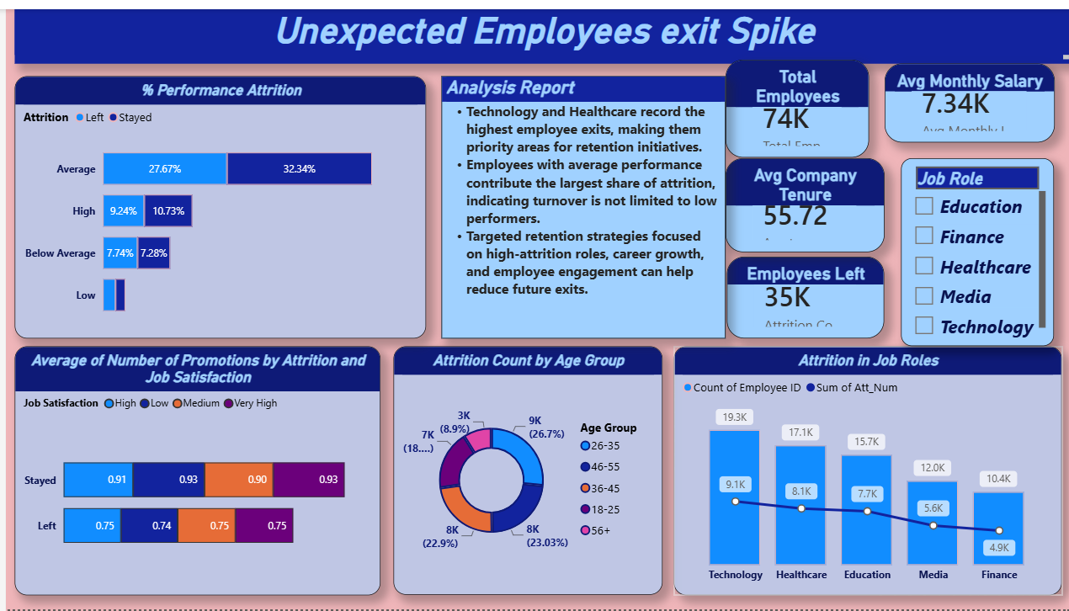

Slide 5
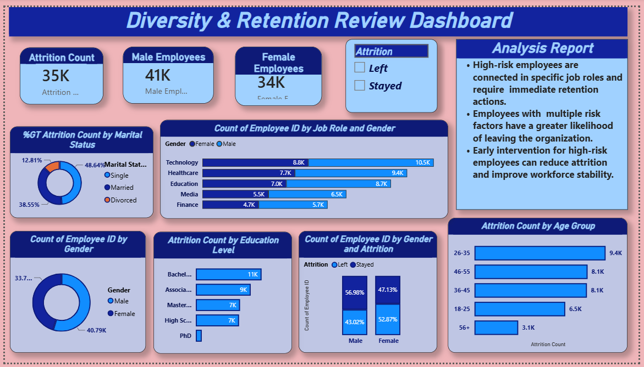

Slide 6
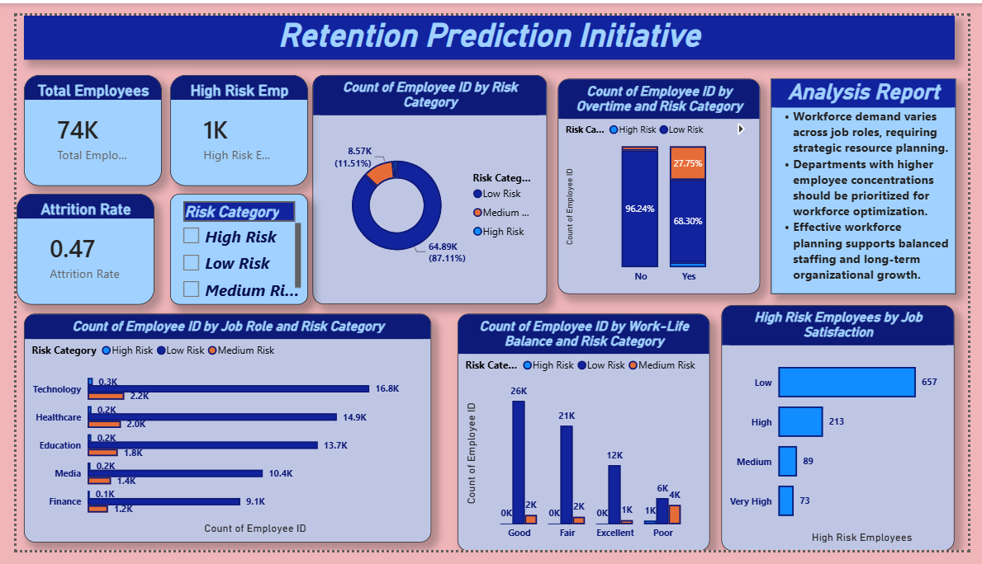

Slide 7
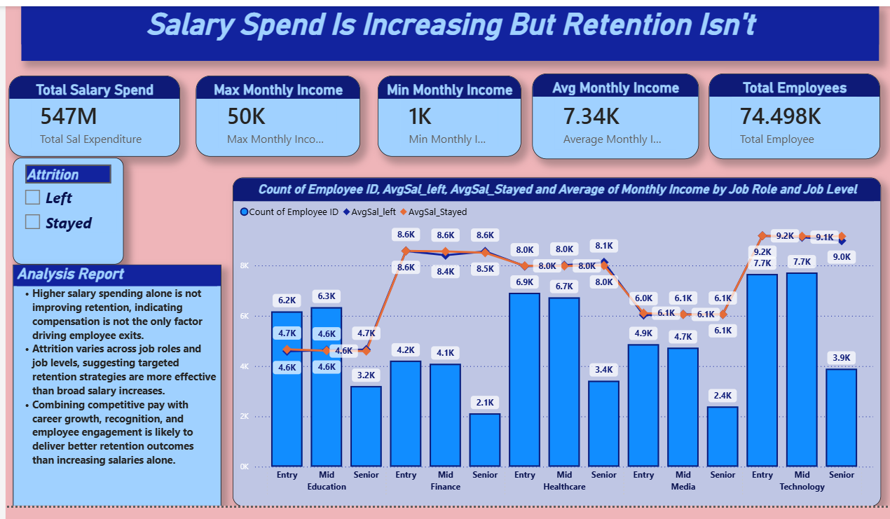

Slide 8
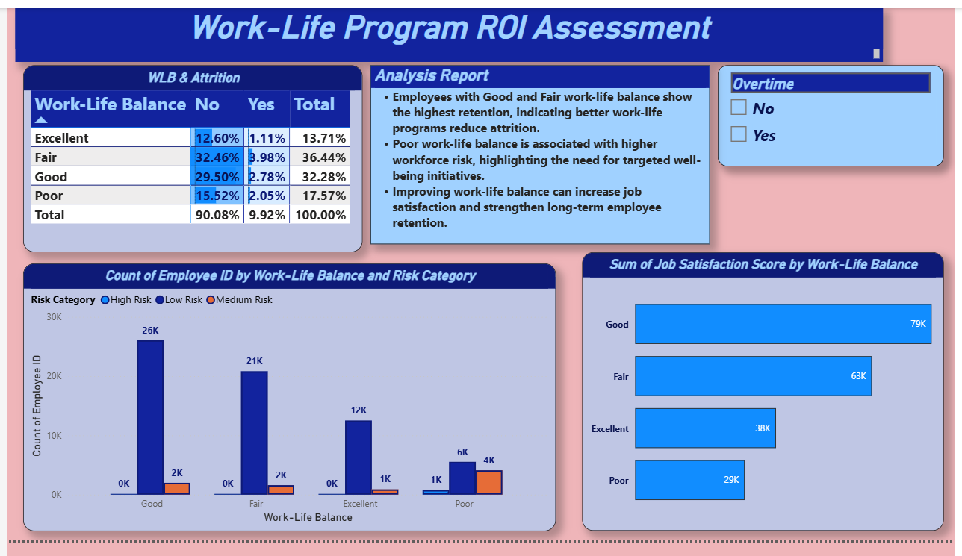

Slide 9
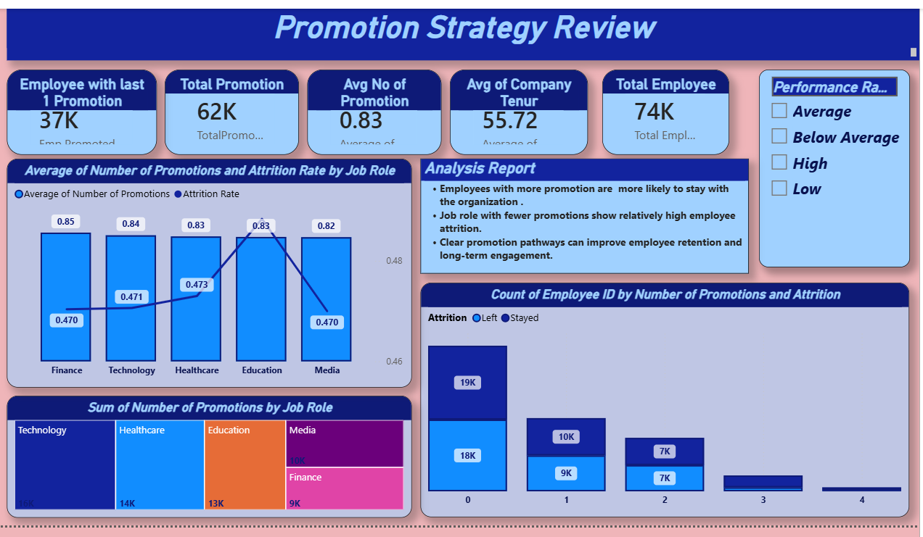

Slide 10
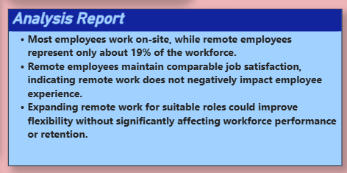
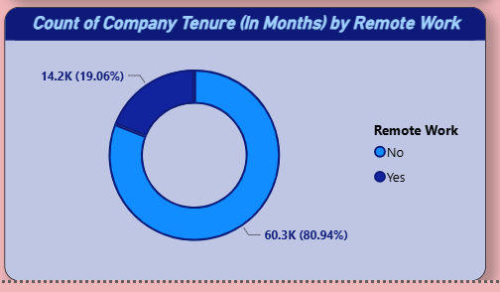
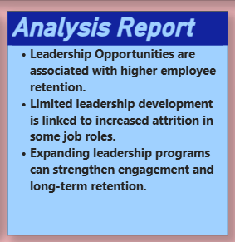
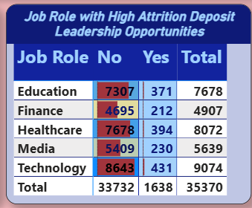

Slide 11
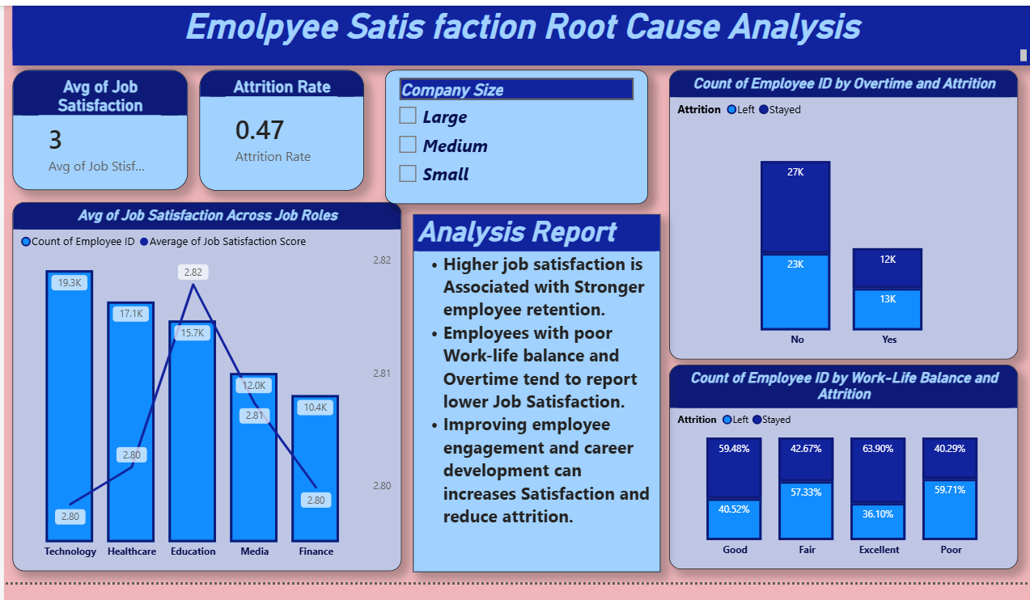

Slide 12
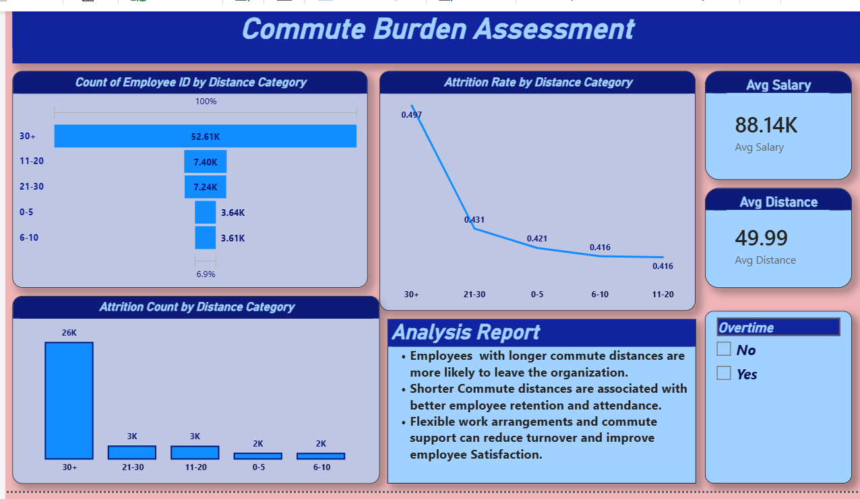

Slide 13
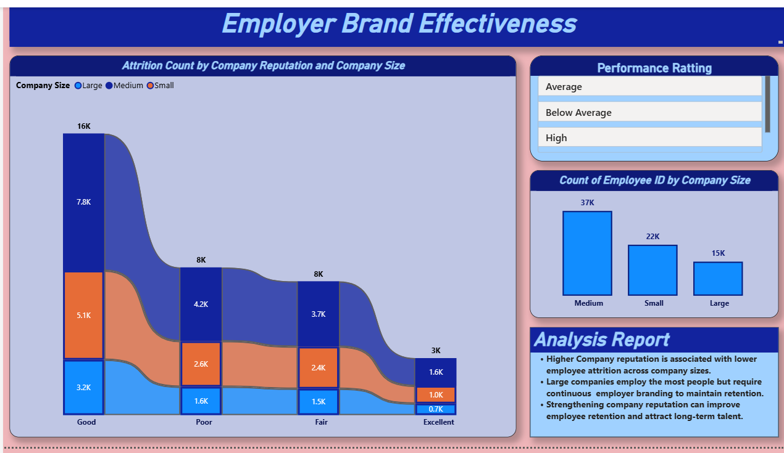

Slide 14
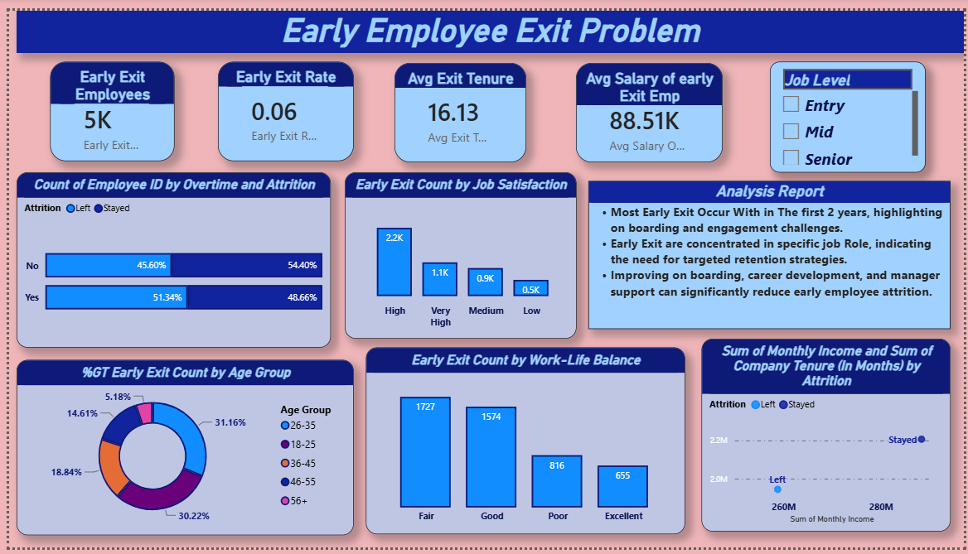

Slide 15
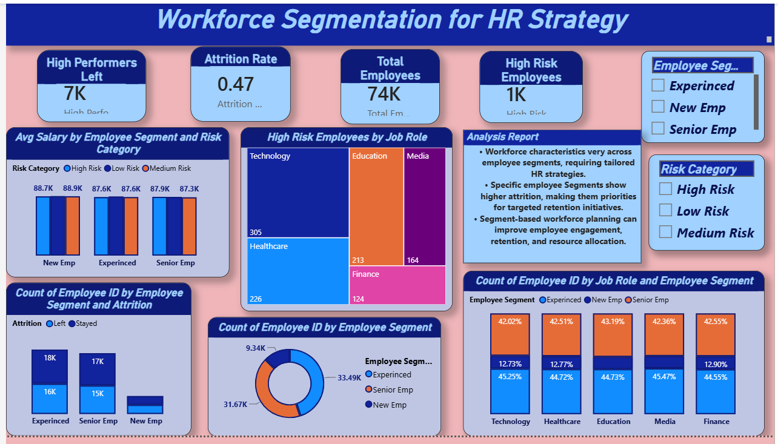

Slide 16
Overall Project Insights
Attrition is mainly influenced by overtime, poor work-life balance, and limited career growth.
Remote work maintains employee satisfaction without reducing performance.
Promotions and leadership opportunities improve retention.
Recognition and company reputation positively impact engagement.
Salary increases alone do not guarantee higher retention.

Slide 17
Recommendations
Improve work-life balance.
Reduce excessive overtime.
Increase leadership opportunities.
Expand flexible remote work.
Strengthen employee recognition.
Provide transparent promotion pathways.

Slide 18
Thank You!
I am happy to answer any Questions.
Question & Answers
Toos Used
Excel
Team 2
HR Analytics Project
Power BI

